Slide 1

Image Steganography For Cyber Security Using C# & .NET Framework
By
Debasis Kar (10908166)
Roopali Sahoo (10901410)
Abhishek Kapoor (10900073)
Project Group Number: KG005
Under The Guidance Of
Er. Sawal Tandon
Assistant Professor, CSE
CAPSTONE PROJECT-II (Jan-Apr, 2013)
Lovely Professional University, Punjab, India

Slide 2
Project Overview
Steganography with Image is a desktop application.
The purpose of this application is to provide the security for the confidential information. This application does not allow the hackers to view the data, can view only image file when it is being passed over the internet.
At the recipient side the original information i.e., plain text will be extracted from the image by performing decryption operations.
This application uses C#.NET to develop GUI and perform encryption and decryption operations.
One can make it pure steganography application including features such as for cyber security:
E-Mail Application
E-Mail Client Service
Messaging Simulation With Password

Slide 3
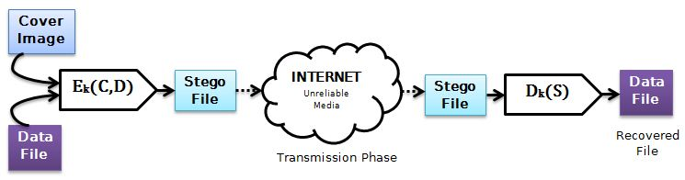
Steganography
Steganography comes from the Greek “Steganos”, which mean “Covered” and “Graphy” mean “Writing or Drawing”. Therefore, steganography mean, literally, “Covered Writing”.
It is the art and science of hiding information such its presence cannot be detected and a communication is happening. The main goal of this projects it to communicate securely in a completely undetectable manner and to avoid drawing suspicion to the transmission of a secret data.
The basic model of steganography consists of Carrier and Message. Carrier is also known as cover-object, which the message is embedded and serves to hide the presence of the message.

Slide 4
Steganography vs Cryptography
Cryptography hides the contents of a secrete message from a malicious people, whereas steganography even conceal the existence of the message.
In cryptography, the system is broken when the attacker can read the secret message. Breaking a steganography system need the attacker to detect that steganography has been used.
It is possible to combine the techniques by encrypting message using cryptography and then hiding the encrypted message using steganography. The resulting Stego-image can be transmitted without revealing that secret information is being exchanged.
There are several suitable carriers below to be the cover-object:
Network protocols such as TCP, IP and UDP
Digital audio formats such as wav, midi, mp3.
Digital video formats such as avi, mpeg and mkv
Text such as null characters, just alike Morse code including html and java
Images file such as BMP, GIF and JPEG, where they can be both color and gray-scale.

Slide 5
Image Steganography
Image steganography techniques can be divided into two groups:
Image Domain techniques encompass bit-wise methods that apply bit insertion and noise manipulation. The image formats that are most suitable for image domain steganography are lossless and the techniques are typically dependent on the image format.
Transform Domain involves the manipulation of algorithms and image transforms. These methods are independent of the image format and the embedded message may survive conversion between lossy and lossless compression

Slide 6
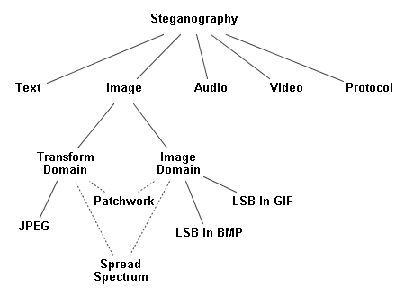
Image Steganography

Slide 7
Least Substitution Method
Least significant bit (LSB) insertion is a common, simple approach to embedding information in a cover image. The least significant bit (in other words, the 8TH bit) of some or all of the bytes inside an image is changed to a bit of the secret message.
When using a 24-bit image, a bit of each of the R, G and B color components can be used, since they are each represented by a byte.
For Example,
A grid for 3 pixels of a 24-bit image can be as follows:
(00101101 00011100 11011100)
(10100110 11000100 00001100)
(11010010 10101101 01100011)
When the number 200, which binary representation is 11001000, is embedded into the LSB of this part of the image, the resulting grid is as follows:
(00101101 00011101 11011100)
(10100110 11000101 00001100)
(11010010 10101100 01100011)
Since there are 256 possible intensities of each primary color, changing the LSB of a pixel results in small changes in the intensity of the colors. These changes cannot be perceived by the human eye - thus the message is successfully hidden.

Slide 8
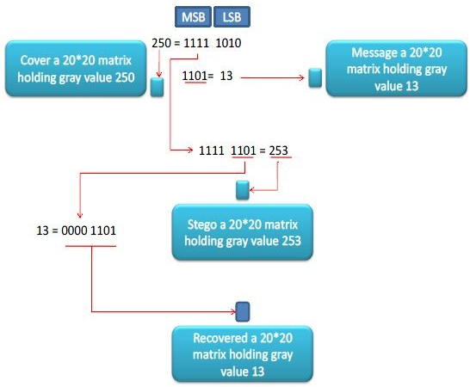
Least Substitution Method

Slide 9
JPEG Steganography
JPEG file can be encoded JFIF encoding that consists of several steps:
The representation of the colors in the image is converted from RGB to Y′C_{B}C_{R}.
The resolution of the Chroma data is reduced, usually by a factor of 2.
The image is split into blocks of 8×8 pixels, and for each block, each of the Y, C_{B}, and C_{R} data undergoes the Discrete Cosine Transform (DCT).
The amplitudes of the frequency components are quantized.
The resulting data for all 8×8 blocks is further compressed with a lossless algorithm, a variant of Huffman encoding.
During the DCT transformation phase of the compression algorithm, rounding errors occur in the coefficient data that are not noticeable. Although this algorithm is lossy, this property can be used to hide messages.
Using the same principles of LSB insertion the message can be embedded into the least significant bits of the coefficients before applying the Huffman encoding. By embedding the information at this stage, in the transform domain, it is extremely difficult to detect, since it is not in the visual domain.

Slide 10
Technical Details-I
Used Namespaces:
System.IO
System.Text
System.Drawing
System.Drawing.Imaging
System.Security.Cryptography
Used Classes:
Image
Bitmap
Rectangle
FileInfo
Hardware Requirements
⊕ Processor: Pentium-III (or) Higher
⊕ Ram: 64MB (or) Higher
⊕ Cache: 512MB
⊕ Hard disk: 10GB
Software Requirements
⊕ Operating System: Windows NT/2000/XP/Vista/7/8
⊕ Languages: Visual C#
⊕ Framework: Microsoft .NET 3.0 (minimum)

Slide 11
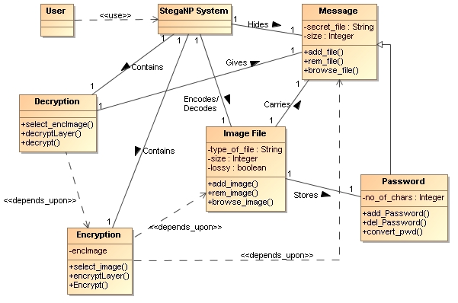
UML Diagrams : CLASS Diagram

Slide 12
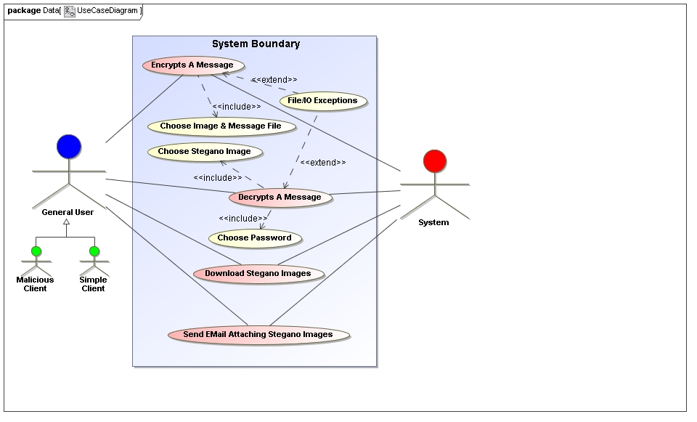
UML Diagrams : Use Case Diagram

Slide 13
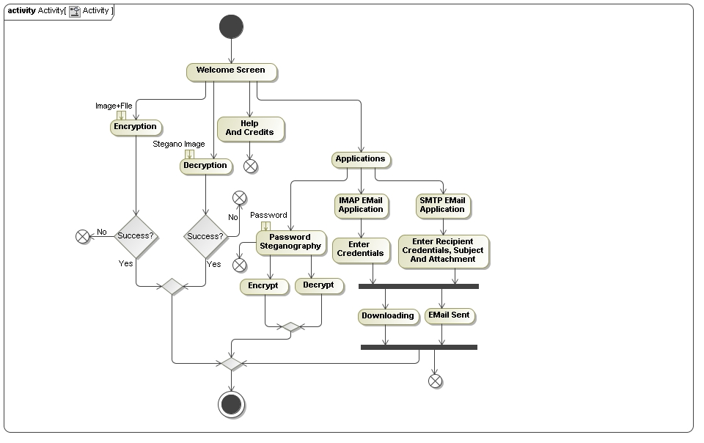
UML Diagrams : Activity Diagram

Slide 14
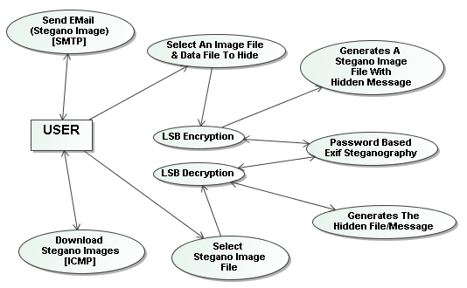
Preliminary DFD (Level-II) : Without Any DataSource

Slide 15
Roles In Project
GUI Designing
LSB Steganography
Unit Testing
Email Application
UI Review
Password Steganography Application
System Testing & Build
Debasis Kar | Password Stegan & LSB Stegan
Abhishek Kapoor | LSB Stegan & System Integration
Roopali Sahoo | GUI Design, Email Application & Testing

Slide 16
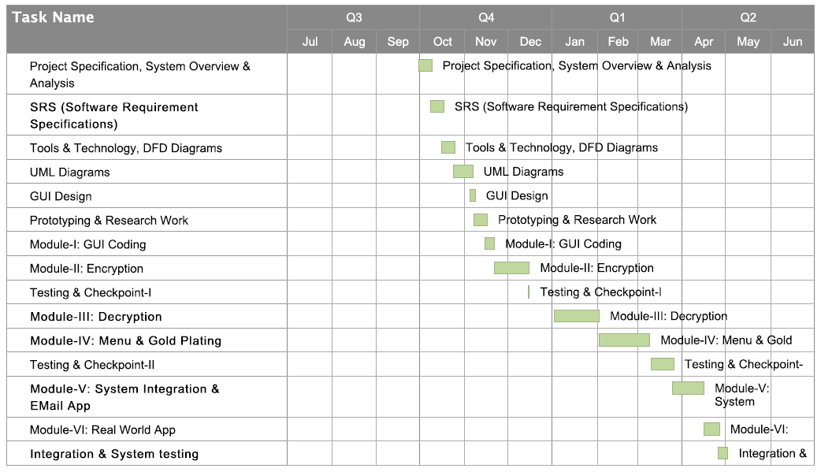
Project Planning

Slide 17
Limitations & Future Scope
To make it pure steganography application including features such as:
Chat Applications
Banking Applications For Safer Data Traffic
Group Messaging Simulation
Users can only send the Stegano Images to Gmail addresses only.
The file size increases by the factor of 2 or 3 after the process of steganography due to manipulation in its bit level. It can be reduced in future to a optimum acceptable level for better flexibility and portability.
The IMAP application is designed over an 3RD party DLL for which the application responds slowly at times. It can be sorted out by introducing some native code.
The LSB algorithm used in the project can be successfully implemented in other platforms such as Android, Windows Phone, iPhone applications to develop steganography based security systems or messaging systems.
Users can only use Gmail, Hotmail or Yahoo mail servers for sending emails.
This project can be ported into other languages such as Java and Python with very few changes.

Slide 18
References
Journals:
Steganography Algorithm To Hide Secret Message Inside An Image, Rosziati Ibrahim And Teoh Suk Kuan , Faculty Of Computer Science And Information Technology, University Tun Hussein Onn Malaysia (UTHM), Malaysia.
Current Steganography Approaches: A Survey Sara Natanj, Taghizadeh, Department Of Industrial Engineering, Kahje-Nassir University Of Technology, Tehran, Iran.
An Overview Of Image Steganography, T. Morkel, J.H.P. Eloff, M.S. Olivier, Information And Computer Security Architecture (ICSA) Research Group, Department Of Computer Science, University Of Pretoria, Pretoria, South Africa.
Books:
CLR via C# by Jeffrey Richter, Tata McGraw Hill Publications.
Professional .NET 4.0 Framework by Joe Duffy, PHI.
C# in Depth by Jon Skeet, 4th Edition, PHI.
Wrox Press Beginning C# 3.0-An Introduction To Object Oriented Programming.

Slide 19
THANK YOU

